Slide 1
Solving Longest Increasing
Subsequence Problem Using Dynamic Programming
Ayan Das
Roll - 311

Slide 2

WARM-UP
Let's Start With a Question
10
22
9
33
21
50
41
60
80
Can you spot an increasing subsequence hiding in this array?
Now — can you find the longest one possible?
One valid answer: 10 → 22 → 33 → 50 → 60 → 80 (length 6)
We'll spend this deck proving that answer — and finding it algorithmically.
LONGEST INCREASING SUBSEQUENCE · DYNAMIC PROGRAMMING
2

Slide 3


BUILDING BLOCKS
Subsequence vs. Subarray
Subsequence
Subarray
Formed by deleting zero or more elements
without changing the order
of the rest.
A contiguous block of elements — nothing in between can be skipped.
• Elements may be skipped
• Relative order is preserved
• Not necessarily contiguous
• No element may be skipped
• Must stay side-by-side
• Always contiguous in memory
10 22 9 33 21 50
10 22 9 33 21 50
↓ keep 10, 22, 33, 50
↓ keep positions 2–4 only
10 22 33 50
9 33 21
LONGEST INCREASING SUBSEQUENCE · DYNAMIC PROGRAMMING
3

Slide 4

FORMAL DEFINITION
The Problem
Given an array of n integers, find the length of the longest strictly increasing subsequence (LIS) — a subsequence whose elements are sorted in increasing order.
INPUT
arr = [10, 22, 9, 33, 21,
50, 41, 60, 80]
OUTPUT
Length = 6
One LIS = 10, 22, 33, 50, 60, 80
→ turn the page for faster approaches
LONGEST INCREASING SUBSEQUENCE · DYNAMIC PROGRAMMING
4

Slide 5


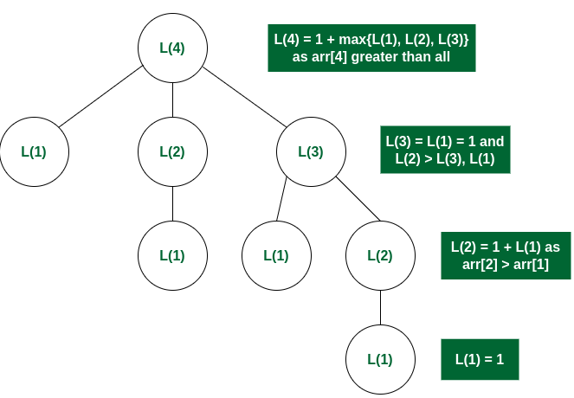
NECESSARY CONDITIONS FOR DP
The Two Conditions DP Requires
Optimal Substructure
Overlapping Subproblems
The best LIS ending at index i is built directly from the best LIS ending at some earlier index j.
Plain recursion recomputes LIS(j) again and again for the same index j — huge waste.
LIS(i) = 1 + max( LIS(j) )
for all j < i
where arr[j] < arr[i]
LIS(4)
LIS(2)
LIS(3)
LIS(3)
An optimal solution to the whole problem contains optimal solutions to its subproblems.
LIS(3) is requested twice — memoization solves it once and reuses the result.
LONGEST INCREASING SUBSEQUENCE · DYNAMIC PROGRAMMING
5

Slide 6
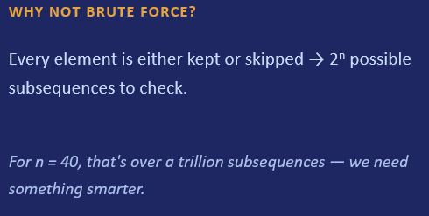
THE PAYOFF
Why DP Instead of Brute Force
Brute force and Dynamic Programming both explore the same keep-or-skip choices for every element — the difference is whether identical subproblems get solved fresh every single time, or only once.
DYNAMIC PROGRAMMING
Optimal substructure lets LIS(i) reuse the answer already found for LIS(j). Overlapping subproblems mean each LIS(j) is computed once, cached, and reused.
For n = 40, that reuse shrinks 2⁴⁰ down to just 40² ≈ 1,600 table lookups.
COST
O(2^{n})
n = 40 → over a trillion candidate subsequences
→ that reuse is exactly what makes Dynamic Programming possible
LONGEST INCREASING SUBSEQUENCE · DYNAMIC PROGRAMMING
6

Slide 7


TWO DIRECTIONS, ONE RECURRENCE
Top-Down vs. Bottom-Up
Top-Down (Memoization)
Bottom-Up (Tabulation)
Start from the full problem and recurse downward, caching each answer the first time it's computed.
Start from the smallest subproblem and iteratively build up dp[] until the full array is covered.
• Recursive, feels natural to write
• Only computes states it actually needs
• Uses call-stack space (risk on huge n)
• Iterative loops, no recursion overhead
• Computes every state exactly once
• Predictable O(n) auxiliary space
HOW IT WORKS
• Ask: “what’s the LIS ending at index i?”
• Already answered before? Return the cached value — no recompute.
• Otherwise, recurse on every earlier index j, take the best result, cache it, then return.
WHY WE USE BOTTOM-UP HERE
• This is the version we’ll code — an iterative dp[] table, no recursion to reason about.
• Easy to trace by hand: fill dp[] left to right, one index at a time — perfect for a board walkthrough.
• No call-stack risk, so it scales safely to large arrays.
LONGEST INCREASING SUBSEQUENCE · DYNAMIC PROGRAMMING
8

Slide 8
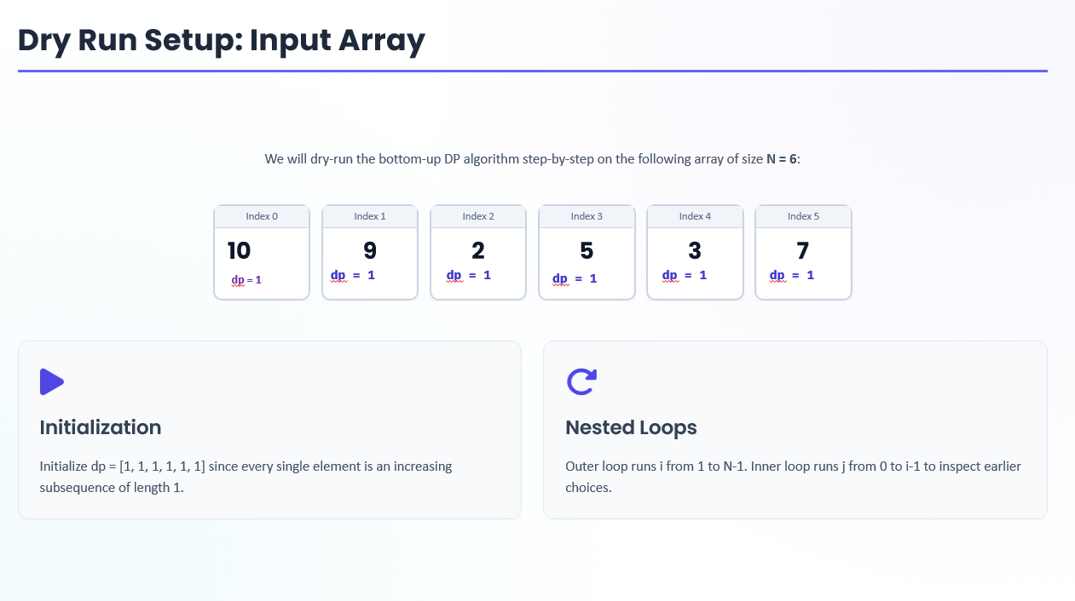

Slide 9
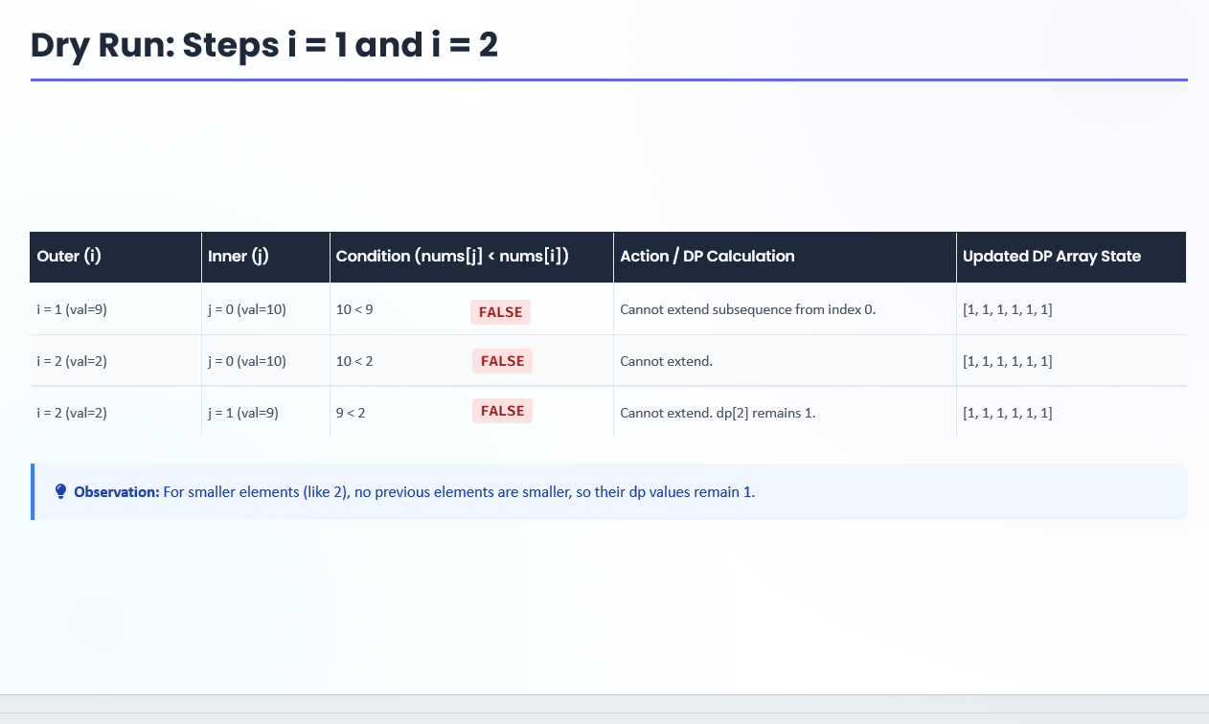

Slide 10
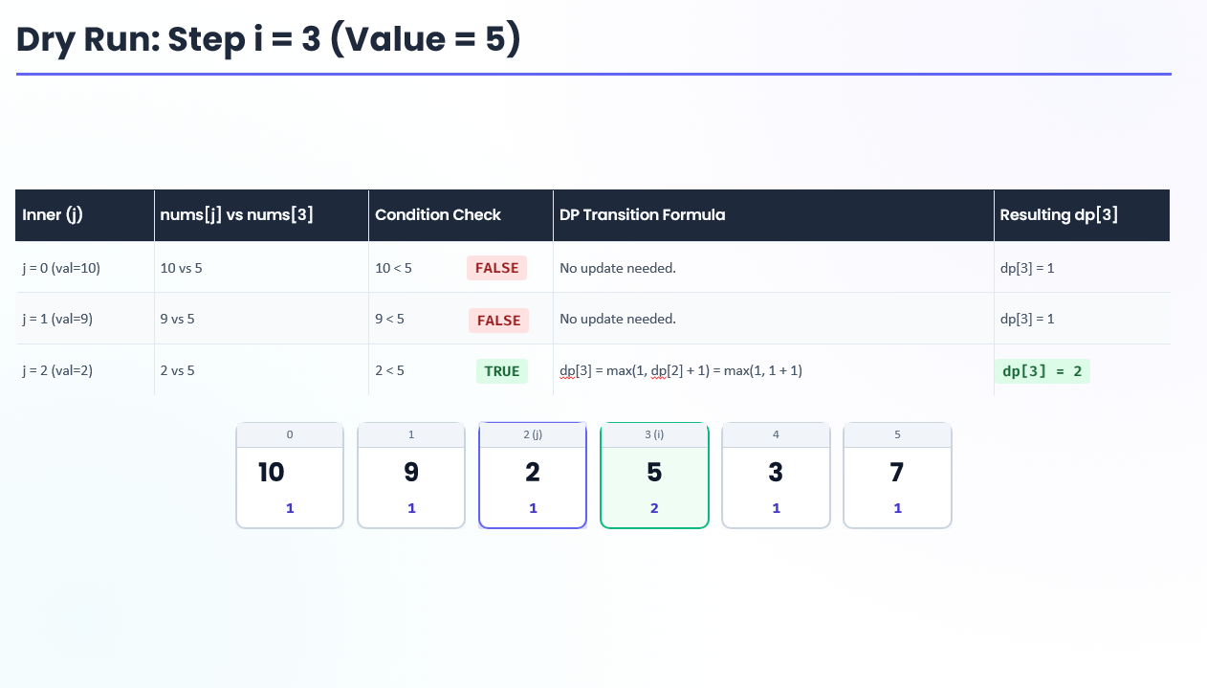

Slide 11
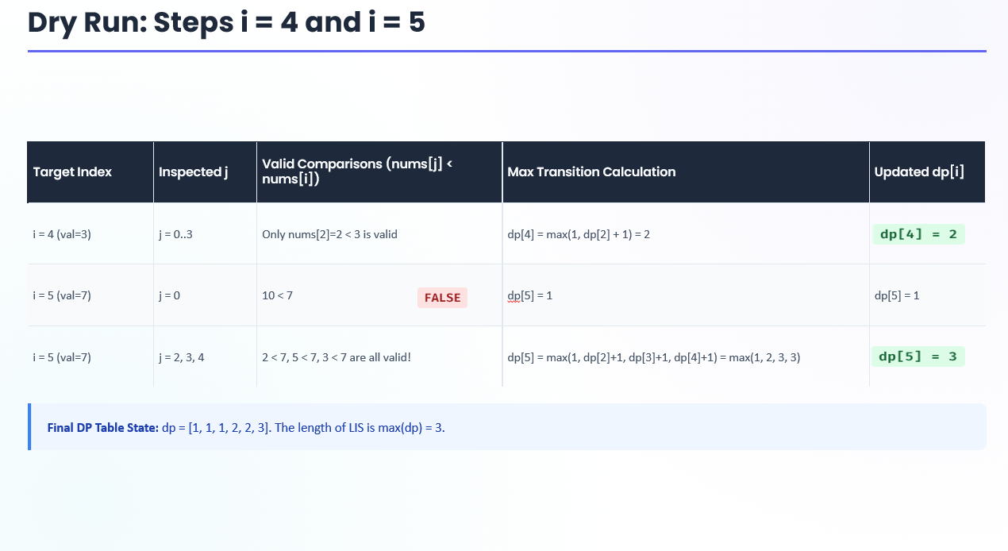

Slide 12
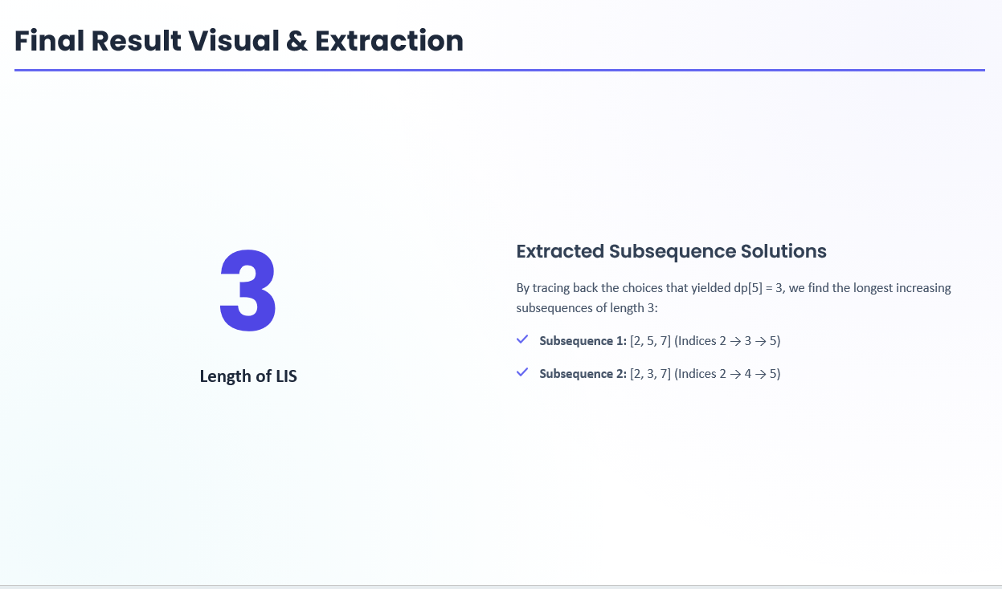

Slide 13
Bottom-Up Approach Dry Run: Filling the dp[] Table
Tracing the bottom-up algorithm on arr = [10, 22, 9, 33, 21, 50, 41, 60, 80]
i
0
1
2
3
4
5
6
7
8
arr[i]
10
22
9
33
21
50
41
60
80
dp[i]
1
2
1
3
2
4
4
5
6
parent[i]
–1
0
–1
1
0
3
3
5
7
max(dp) = 6 at i = 8 → trace parent[]: 8 → 7 → 5 → 3 → 1 → 0
REVERSE THE TRACE TO READ THE SEQUENCE FORWARD
10
→
22
→
33
→
50
→
60
→
80
Length = 6
LONGEST INCREASING SUBSEQUENCE · DYNAMIC PROGRAMMING
9

Slide 14
APPROACH · BOTTOM-UP
Tabulation: The Core Algorithm
dp[i] = length of the longest increasing subsequence that ends exactly at index i.
// dp[i] = 1 for every i (a single element
// is always an increasing subsequence)
// parent[i] = -1 for every i
for (i = 1; i < n; i++)
for (j = 0; j < i; j++)
if (arr[j] < arr[i] &&
dp[j] + 1 > dp[i]) {
dp[i] = dp[j] + 1;
parent[i] = j;
}
// answer = max value inside dp[]
What each line does
• Outer loop i — the element we're currently deciding on
• Inner loop j — every earlier candidate predecessor
• arr[j] < arr[i] — order must stay increasing
• dp[j]+1 > dp[i] — only update if it's actually longer
• parent[i] = j — remembered for reconstruction later
Complexity: two nested loops over n → O(n²) time, O(n) space for dp[] and parent[].
LONGEST INCREASING SUBSEQUENCE · DYNAMIC PROGRAMMING
10

Slide 15
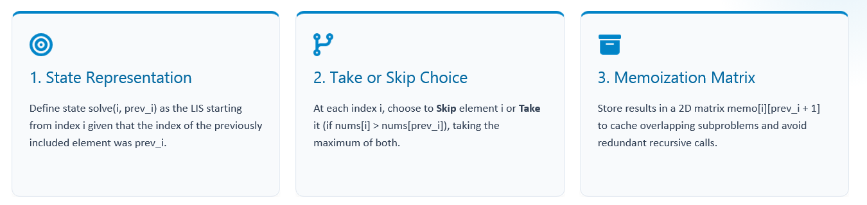
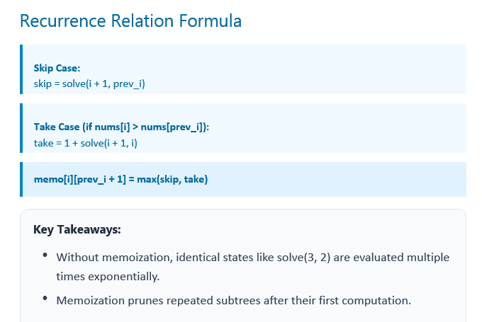
Bottom-Up Approach

Slide 16
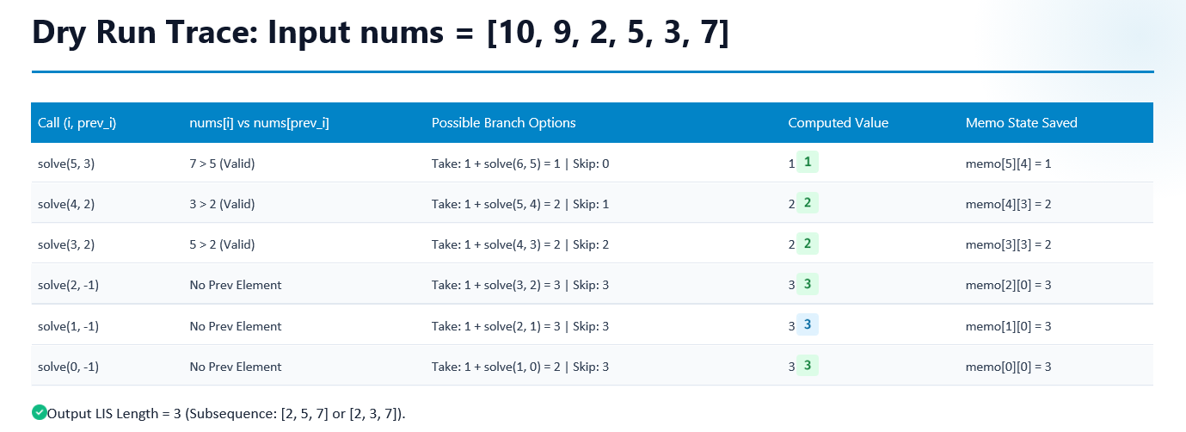
Top Down Approach : Dry Run a Problem

Slide 17
Why Bottom-Up Instead Of Top-Down?
Although LIS can be solved using both Top-Down (Memoization) and Bottom-Up (Tabulation), the Bottom-Up approach is generally preferred because it avoids recursion overhead, uses no recursive call stack, naturally follows the dependency of the problem, and makes reconstruction of the actual LIS easier using the parent[] array. Therefore, it is simpler and more efficient in practice.

Slide 18
THE FASTER PROCESS
Binary Search
The idea is to simulate the process of finding a subsequence by maintaining a list of "buckets" where each bucket represents a valid subsequence. Initially, start with an empty list and iterate through the input vector array from left to right.
Why it's O(n log n)
Each of the n elements is placed with one binary search over the tails[] array, which never has more than n entries — n searches × O(log n) each.
Example: arr = [3, 10, 2, 1, 20], why keeping 1 (the smallest value) helps?
Use binary search to find the position where new element is to be inserted.
First two elements: buckets = [3, 10]
arr[2] = 2 buckets = [2, 10] -> replaces 3
arr[3] = 1 buckets = [1, 10] -> 1 replaces 2 as it's smaller
arr[4] = 20 buckets = [1, 10, 20] -> 20 is appended as it's larger
This shows that by replacing 3 with 1, we created the opportunity to find the subsequence [1, 10, 20], which is longer than our initial [3, 10]. If we had kept [3, 10], we wouldn't have been able to add 2 to our sequence!
tails[] is not always a valid subsequence itself — recovering the actual sequence needs extra bookkeeping.
LONGEST INCREASING SUBSEQUENCE · DYNAMIC PROGRAMMING
12

Slide 19
SIDE BY SIDE
Comparing the Approaches
Approach
Core Idea
Time
Space
Recovers Sequence?
Brute Force
(Recursion)
Try every possible subsequence
O(2ⁿ)
O(n)
Yes, but impractical
DP — Top-Down
(Memoization)
Recurse + cache each subproblem once
O(n²)
O(n)
+ call stack
Yes, with extra tracking
DP — Bottom-Up
(Tabulation)
Iteratively fill dp[] left to right
O(n²)
O(n)
Yes — via parent[]
Binary Search
Maintain smallest tail per length
O(n log n)
O(n)
Length only, by default
Rule of thumb: reach for the O(n²) DP when you need the actual sequence and n is modest; switch to binary search once n grows large and only the length matters.
LONGEST INCREASING SUBSEQUENCE · DYNAMIC PROGRAMMING
13

Slide 20
APPLICATION
Bioinformatics
LIS is used in bioinformatics to compare DNA sequences and find common ordered patterns. It helps researchers identify important genetic similarities, study evolution, and analyze diseases.
Stock Analysis
LIS helps identify the longest period of increasing stock prices. Financial analysts use it to study market trends and evaluate stock performance over time.
LONGEST INCREASING SUBSEQUENCE · DYNAMIC PROGRAMMING
14

Slide 21

KNOW THE TRADE-OFFS
Limitations of the DP Approach
Quadratic time
Extra bookkeeping for the sequence
Strict vs. non-strict ordering
O(n²) becomes slow past roughly n ≈ 10⁴–10⁵; the binary-search method is needed at real scale.
The recurrence alone only yields the length — a parent[] array (or similar) is required to reconstruct an actual LIS.
Switching between strictly increasing and non-decreasing subsequences means changing < to ≤ everywhere — an easy detail to get wrong.
Recursion depth (top-down)
Not built for streaming data
Only one LIS by default
Memoized recursion can hit call-stack limits on very large arrays without careful iterative rewriting.
The formulation assumes the full array is known upfront; it doesn't natively support elements arriving one at a time.
Counting all distinct longest subsequences — not just finding one — needs a separate, extended DP formulation.
LONGEST INCREASING SUBSEQUENCE · DYNAMIC PROGRAMMING
15

Slide 22
Thank You

Slide 23
SOURCES
References
1
Geeks For Geeks : LIS Solved By Using Dynamic Programming
2
YouTube Videos :
https://youtu.be/IFfYfonAFGc?si=HC0jWa90PWqd1QHY
https://youtu.be/E6us4nmXTHs?si=CRGbNTGY2lwuznuH
https://youtu.be/ekcwMsSIzVc?si=321Vu_RK7R-K-amf
https://youtu.be/on2hvxBXJH4?si=GlyA59E6uDYCmJna
3
5
LONGEST INCREASING SUBSEQUENCE · DYNAMIC PROGRAMMING
17

